Slide 1
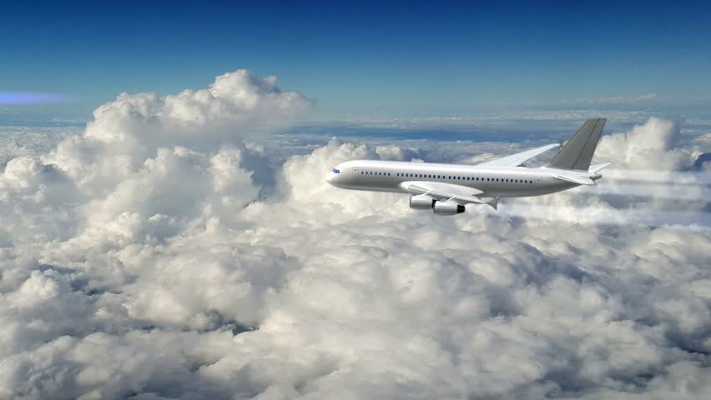
U.S.A Flight Predictions
By:
Natalie St
Loba Q
Nitha B

Slide 2

Contents
Development
Variants
Operators
Specifications

Slide 3
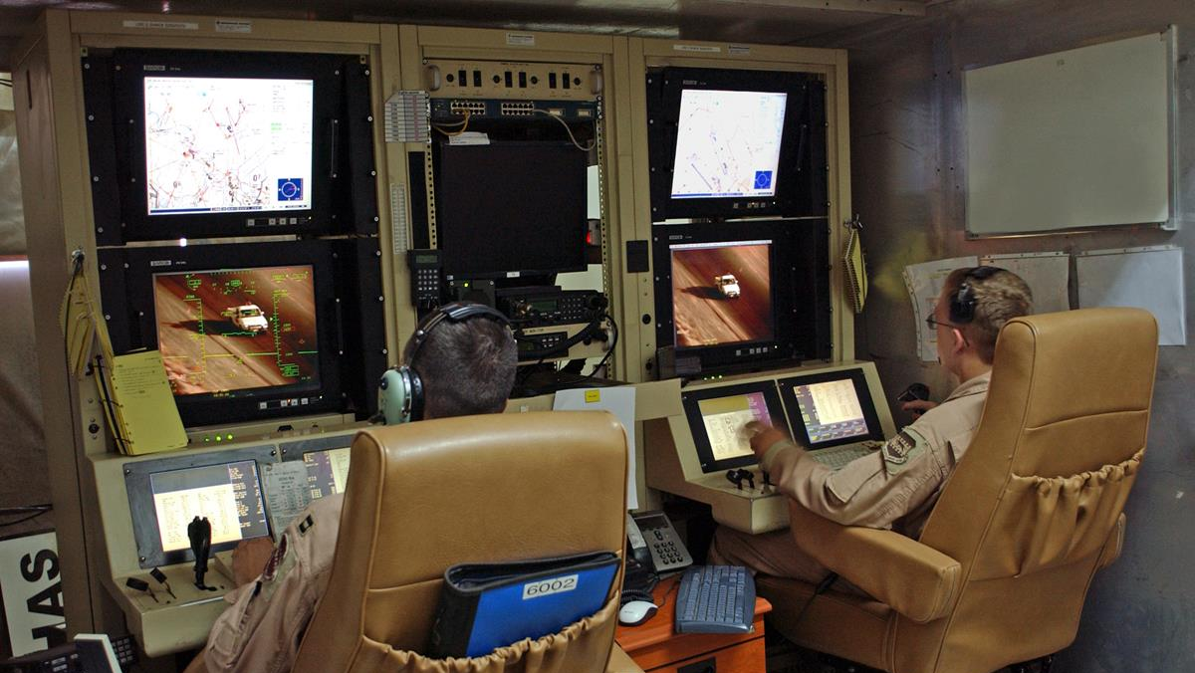
Machine Learning Developmental Models
Linear
Ridge
Classification
Notes:
Consider talking about:
Command and sensor systems
Deployment methodology
Armed versions
Later development and future

Slide 4
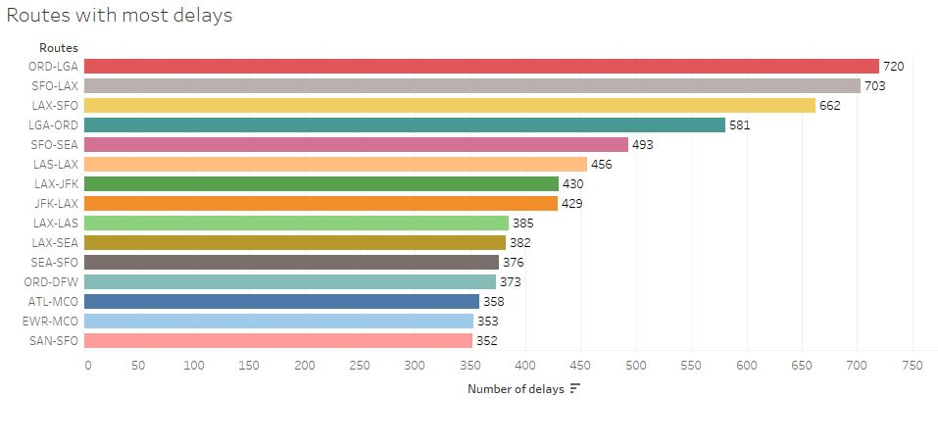
Routes with most delays
O'Hare Chicago International Airport to LaGuardia Airport
SFO to LAX
LAX to SFO

Slide 5
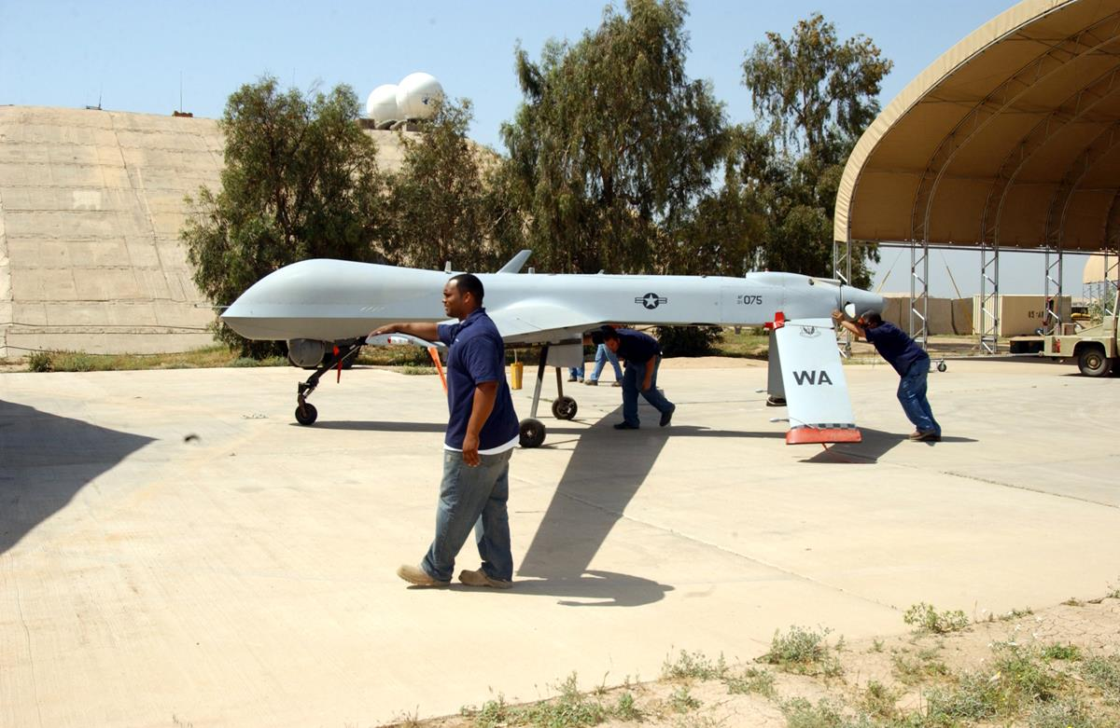
Operators

Slide 6
Specifications

Slide 7
Works cited

